Slide 1
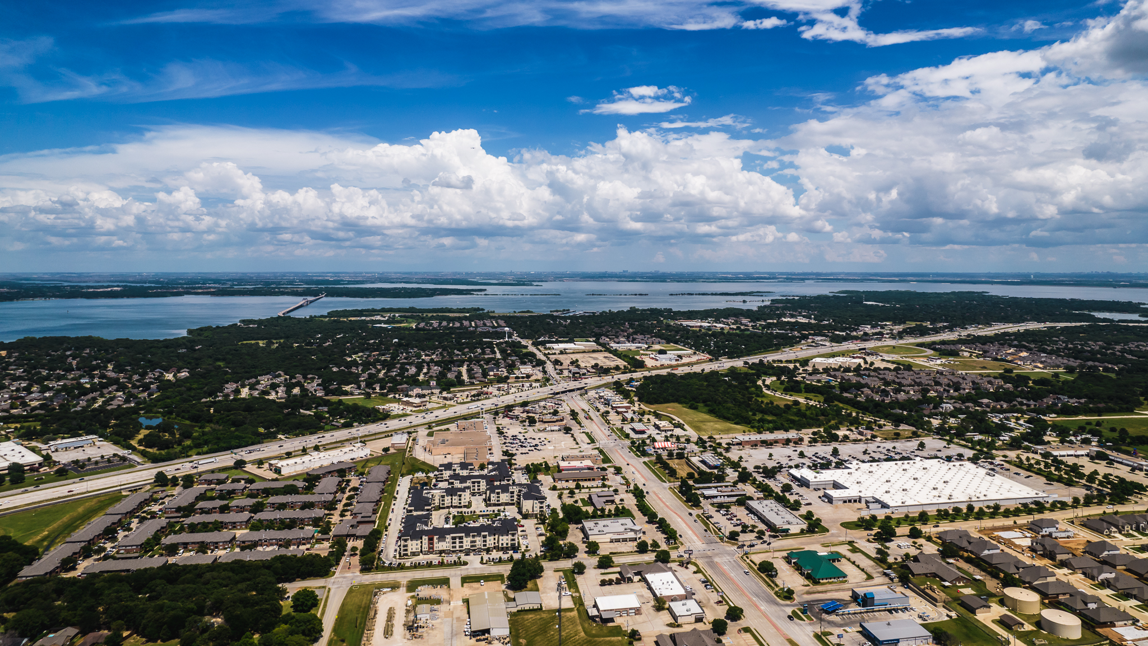
PUBLIC SAFETY REGIONALIZATION FEASIBILITY STUDY
Police Services
Lake Dallas – Corinth – Shady Shores

Slide 2
PURPOSE
To determine if a consolidation of Police Services will achieve a more effective and efficient delivery of key public safety services to all three communities.

Slide 3
HISTORICAL ADVANTAGES OF REGIONALISM
Improve overall police services to served communities
Better utilization of building and technical resources
Improved sharing of police data
Improved compliance with state and national standards
Improved employee satisfaction and retention
Cost and liability savings

Slide 4
WHY CONDUCT A FEASIBILTY STUDY NOW?
Understanding and commitment from police administrators that consolidation of services is cost effective and could enhance services for communities and safety for police personnel.
Currently, both cities utilize the same radio system, CAD, and records management systems.
Communities share a contiguous border and Police mutual aid compacts are already in place.
Lake Dallas and Corinth would like to improve staffing levels of their respective police departments but face budget obstacles to do so.
Future direction for small to medium size departments.
Growing level of police service needs and a rapidly changing landscape requiring innovation to meet those needs.

Slide 5
WHAT WOULD THE FEASIBILITY STUDY CONSIST OF?
Internal/External Communication Plan consisting of:
Town Hall Meetings to educate and solicit input from community members in Lake Dallas, Corinth, and Shady Shores.
Surveys:
Internal
External
Service Delivery
Workload Analysis that would identify:
Police service needs in the communities of Lake Dallas, Corinth, and Shady Shores.
Identify resources to meet the identified needs.
Resource deployment

Slide 6
WHAT THE PROPOSED FEASIBILITY STUDY IS NOT
The dissolution of the Lake Dallas Police Department and absorption by the Corinth Police Department.
A decision by city council to consolidate police services with the City of Corinth. This decision would not be made until the end of the term after the final report had been submitted and reviewed.

Slide 7
INTERLOCAL AGREEMENT CONSIDERATIONS
Agreement would commence on September 1, 2021, and run to August 31, 2022.
Corinth’s Police Chief will be designated by Lake Dallas to serve as the Interim Police Chief of Lake Dallas’ Police Department.
Police services within and provided to each of the Cities shall remain at the same level or higher level as currently provided by each of the Cities within its boundaries without any disruption of service delivery in either City.
The command staffs of the Cities’ police department shall be integrated and operate as if the police departments were a single police department.
Personnel from the Cities’ police department shall respond to calls for assistance and other purposes within the boundaries of both Cities as if acting as one police department pursuant to operational procedures enacted by the Interim Chief. Interim Chief shall consult with the police department command staffs of both Cities when enacting such operational procedures.
The Cities agree their respective police departments shall continue to operate in accordance with the standard operating practices and procedures adopted by the respective police departments.

Slide 8
INTERLOCAL AGREEMENT CONSIDERATIONS
Lake Dallas agrees to pay Corinth for administrative services, including providing the services of the Interim Chief, in the amount of $75,000.00 (the “Administrative Fee”) for the term of this Agreement; such amount to be paid in four (4) equal installments of $18,750.00 each due on October 1, 2021, January 5, 2022, April 1, 2022, and July 1, 2022, respectively. The Cities agree that the Administrative Fee to be paid pursuant to this Section 5 is not based upon any experience or actual costs incurred by Corinth but is merely a negotiated fee that Corinth agrees is a reasonable fee paid to compensate Corinth for the services provided by Interim Chief during the term of this Agreement.
During the term of this Agreement, the Cities agree to obtain the professional services necessary for the performance of a study to determine the feasibility of consolidating the Cities’ police departments into a single operational unit (the “Study”). Corinth shall be responsible for entering into and paying for the necessary contracts for the performance of the Study; provided, however, no contract for the performance on the Study shall be executed by Corinth unless and until Lake Dallas has approved (i) the proposed contents of the Study, including the subject matters to be addressed in the Study, (ii) the scope of services to be performed by the contracted professional in relation performance of the Study, and (iii) the person or entity that Corinth proposes be selected to perform the Study, which approvals shall not be unreasonably withheld. Corinth agrees to make reasonable efforts to engage the professional to perform the Study in sufficient time that the Study is presented in final form to the Cities not later than July 1, 2022.

Slide 9
INTERLOCAL AGREEMENT CONSIDERATIONS
Either City shall have the right to terminate this Agreement prior to the end of the term of this Agreement by delivering written notice to the other City not later than sixty (60) days prior to the date of Termination set forth in such notice.

Slide 10

QUESTIONS?

