Slide 1

Comprehensive plan Review 02/12/2026

Slide 2
Key Provisions of Texas Local Government Code Chapter 213
Legal Element | Description
Adoption Requirement | Plan adoption is optional; cities may adopt but are not required.
Content Flexibility | Cities define content and may include land use, transportation, and public facilities.
Adoption Process | Requires ordinance, public hearing, and planning commission review (if applicable).
Legal Effect | Plan is advisory and not zoning; zoning generally must align with plan.
Plan Structure | May be a single document or a coordinated set of plans.
Notes:
Texas state law regarding municipal comprehensive plans is primarily governed by Chapter 213 of the Texas Local Government Code, which outlines the permissive and flexible nature of comprehensive planning within the state. A key aspect of this legislation is that municipalities are not mandated to adopt a comprehensive plan; instead, the statute explicitly states that a city may adopt such a plan for long-range development, giving municipalities broad discretion in determining whether comprehensive planning aligns with their local governance objectives.
The content and structure of the plan are likewise determined by each city, allowing for a tailored approach that may include elements such as land use policies, transportation frameworks, public facility planning, and other components relevant to guiding community growth. This flexibility extends to the option of creating either a single unified plan or a collection of coordinated plans that address different geographic areas or thematic subjects within the city.
Another central provision of the chapter is the requirement that adoption or amendment of a comprehensive plan occur through an ordinance, accompanied by at least one public hearing and review by the municipality’s planning commission or department if one exists. This ensures transparency and encourages public participation in shaping long-term development strategies, although the law does not prescribe additional procedural obligations unless a municipality chooses to implement them.
Importantly, the statute clarifies that a comprehensive plan serves as a policy guide rather than a regulatory instrument and therefore does not constitute zoning. Future land use maps must include clear labeling to distinguish the guidance of the plan from enforceable zoning regulations.
Finally, while zoning regulations under Chapter 211 must be adopted in accordance with a comprehensive plan, Texas courts have consistently interpreted this as requiring only general alignment rather than strict consistency, allowing cities to enforce zoning ordinances regardless of the existence or specificity of a comprehensive plan. This nuanced relationship between planning and zoning underscores the high degree of local control inherent in Texas land use law.

Slide 3
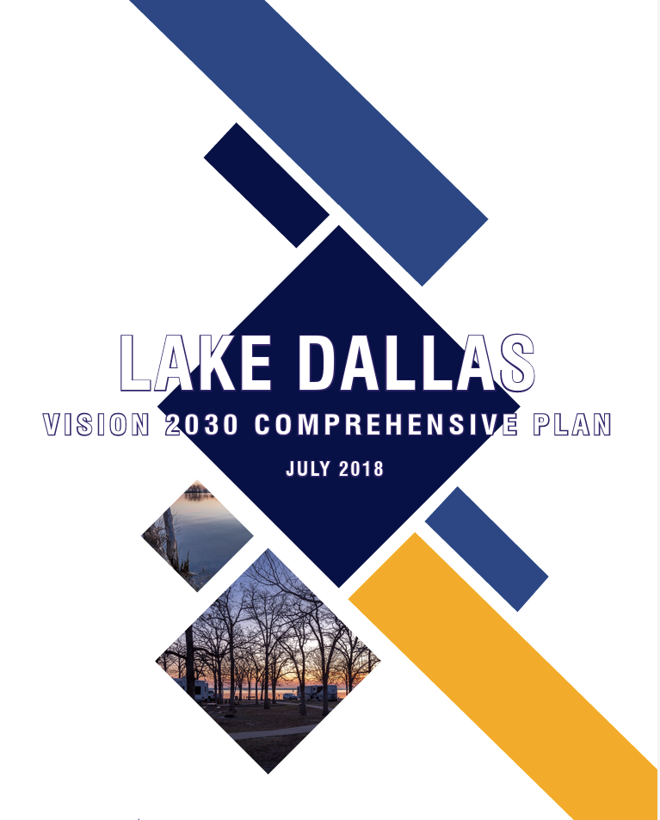
Lake Dallas Comprehensive Plan
What is a Comprehensive Plans :
A comprehensive plan for a city is a long-term, strategic document that outlines a city's vision for the future, including how it wants to grow, develop, and manage its resources. It acts as a roadmap for guiding future decisions related to land use, infrastructure, and community development. Essentially, it's a blueprint for the city's future, setting the stage for how it will evolve over the next 10-20 year.
Comprehensive Plans Should Be:
Future Oriented
Continuous
Based on a determination of present and projected conditions
Act as a guiding document

Slide 4
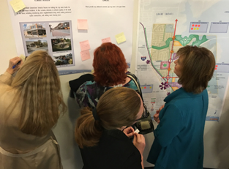
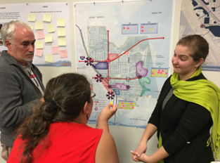
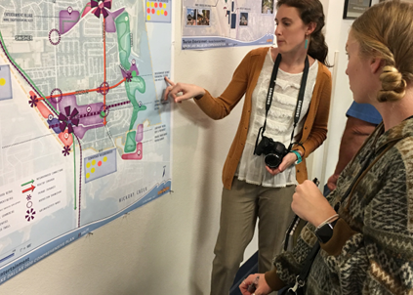
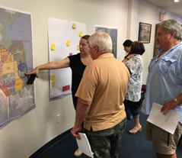
Comprehensive plan creation + timeline
PHASE 1
PHASE 3
Project Initiation and Status of Lake Dallas
Mid-2017
2nd Public Workshop
(Keypad polling)
August 17, 2017
3rd Public Workshop
October 24, 2017
City Council and P&Z Commission Workshop
January 17, 2018
1st Public Workshop
June 15, 2017
Recommended for Approval by Planning & Zoning
May 2018
Approved by City Council
June 2018
PHASE 2

Slide 5
lake Dallas comprehensive plan - topics
INTRODUCTION
LAND USE & URBAN DESIGN
HOUSING
COMMUNITY PROFILE
MOBILITY
DOWNTOWN
VISION & GOALS
PARKS, TRAILS, & OPEN SPACE
IMPLEMENTATION & MONITORING

Slide 6
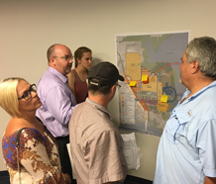
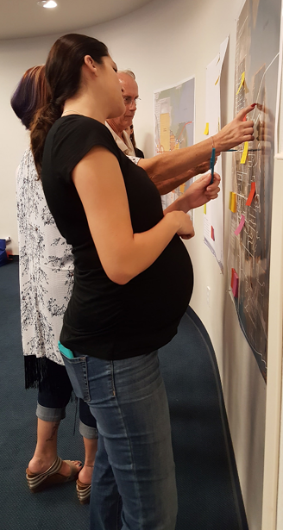
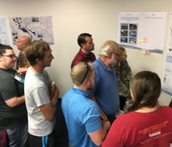
Comprehensive Plan – vision
Vision Statement: Lake Dallas is a welcoming community filled with exciting lakeside recreation, a vibrant downtown, and thriving neighborhoods while retaining its unique, small-town charm.
Guiding Principles:
Create a recreation destination intertwined with lakefront amenities to draw people in from around the Metroplex and provide a high quality of life for residents.
Create a highly connected city with strong economic drivers along major roads.
Create an inviting, visually pleasing city with a destination downtown that contains a variety of eclectic shops and neighborhood serving retail opportunities.

Slide 7
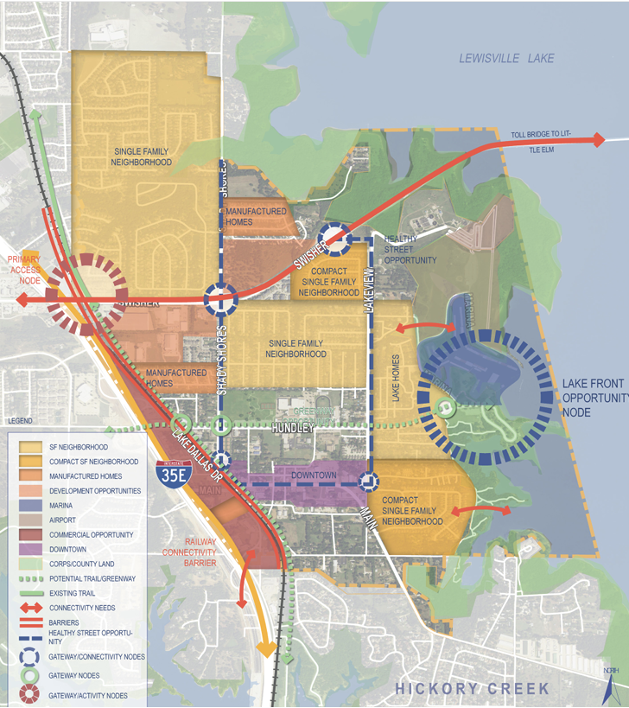
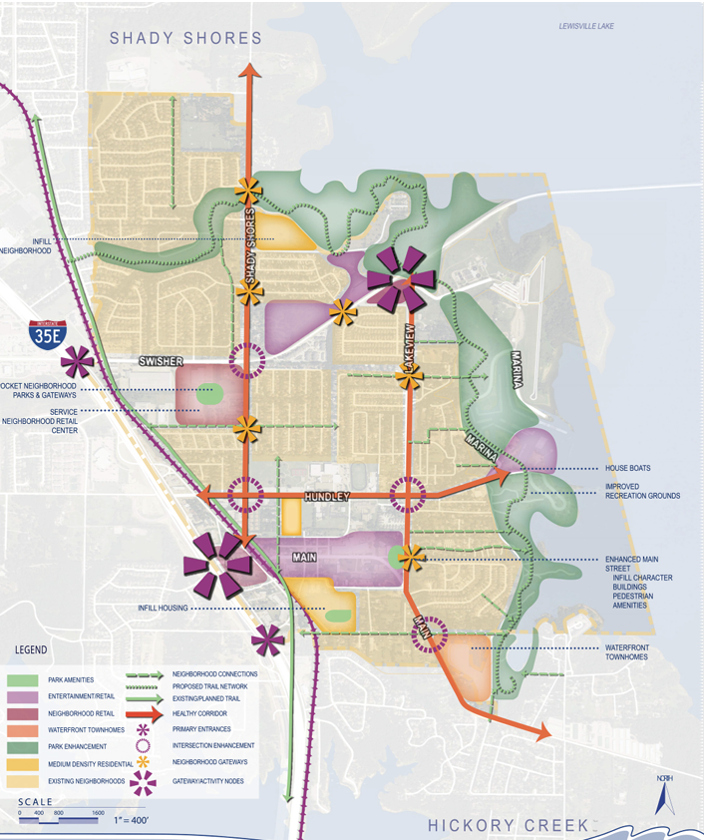
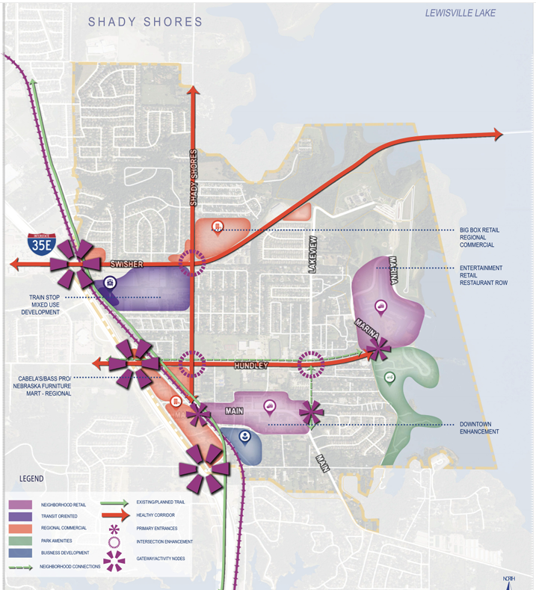
Scenario Development vision
Neighborhood Connections Scenario
Enhanced Main Street
Neighborhood Retail Centers
Healthy Corridors
Pocket Neighborhood Parks
Neighborhood Districts
New Housing Types
Economic Development Scenario
Regional Commercial
Entertainment Retail
Gateways
Downtown Enhancement
Train Stop
Tourism/Entertainment Scenario
Water Park
Entertainment Village
Expanded Downtown
Focal Features
Paddle Launch
Proposed Trails

Slide 8
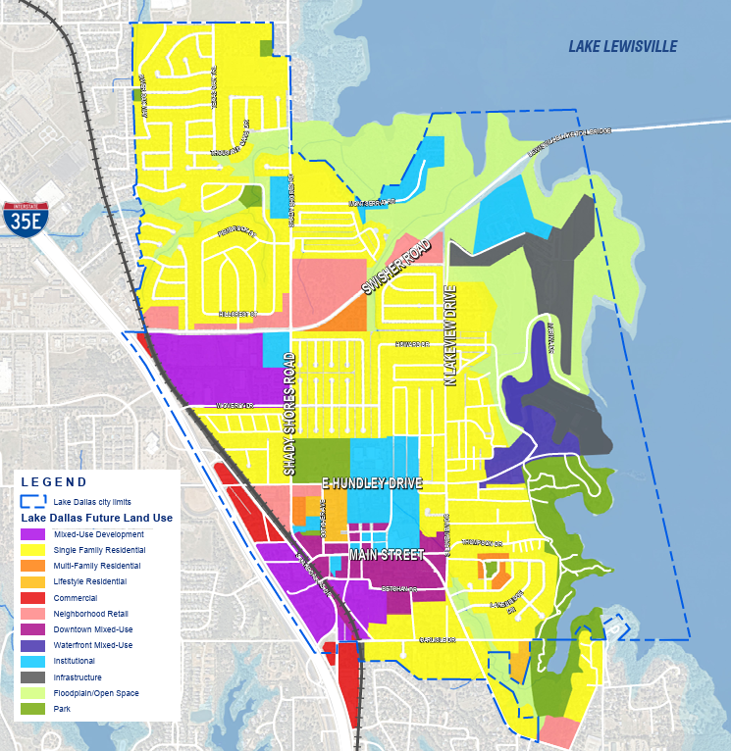
Land use & urban design
Future Land Use Map
Land Use Framework: Create economic development opportunities along I-35 and focus on neighborhood-serving retail, unique eclectic tourism districts, and local business opportunities east of the railroad.
Land Use Designations:
Single Family Residential
Multi-Family Residential
Lifestyle Residential
Neighborhood Retail
Commercial
Institutional
Parks
Floodplain/Open Space
Infrastructure
Waterfront Mixed-Use
Downtown Mixed-Use
Mixed-use

Slide 9
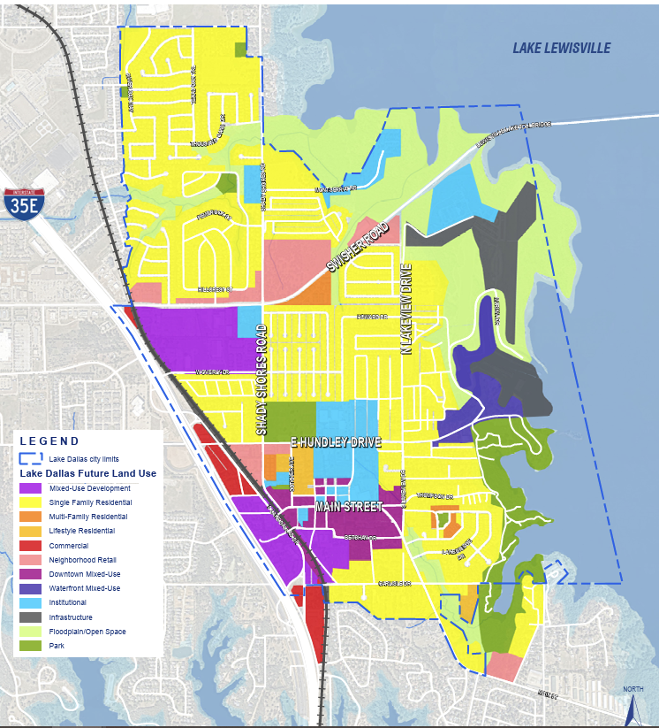
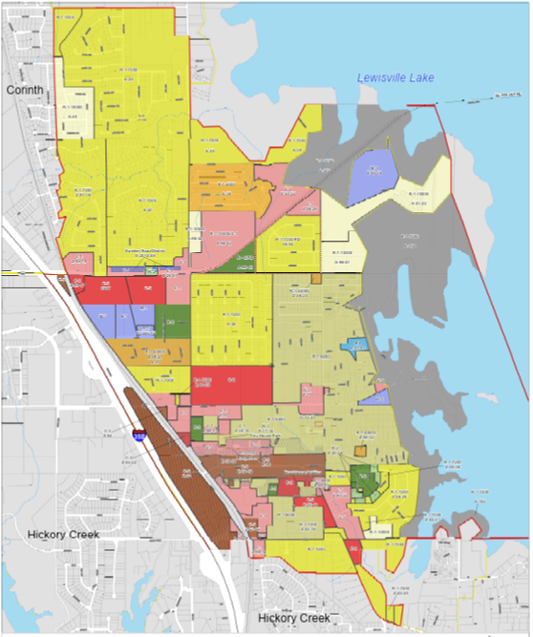
Differences Zoning & Future Land Use Map
Future Land Use Map acts as a vision and guide for the future and does not have regulatory actions
Zoning is specific and acts as a regulatory framework that implements regulations
Notes:
In Lake Dallas, the Future Land Use Map is a policy guide—not a zoning regulation. The zoning ordinance does not require strict consistency with the map, and zoning decisions are made legislatively based on multiple factors and public input.

Slide 10
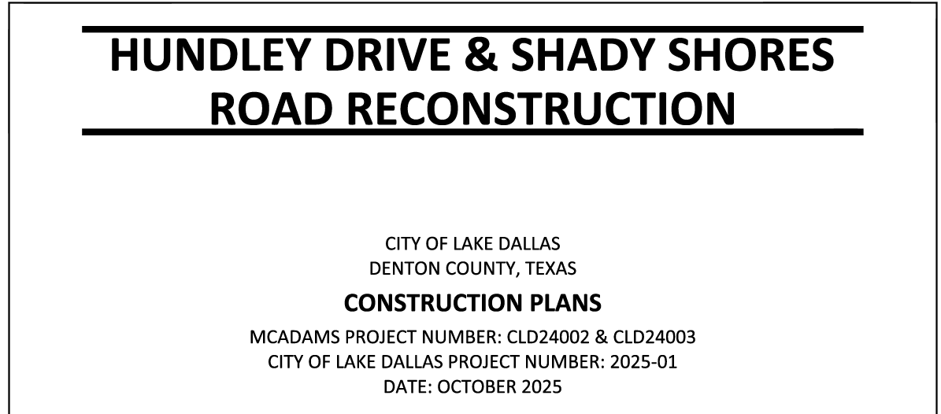
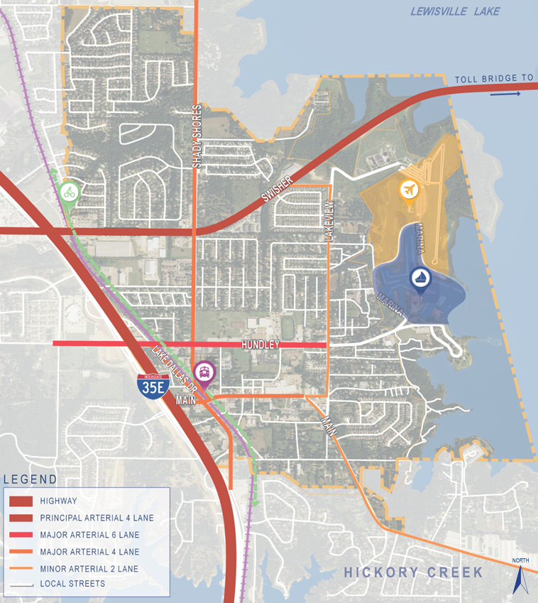
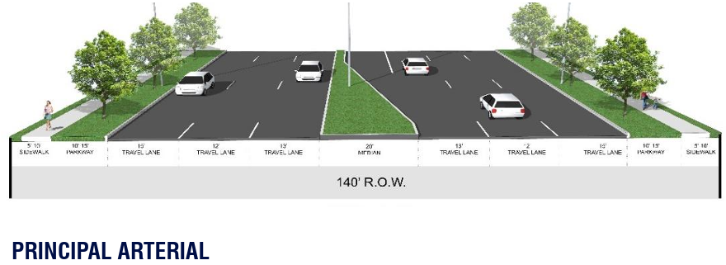
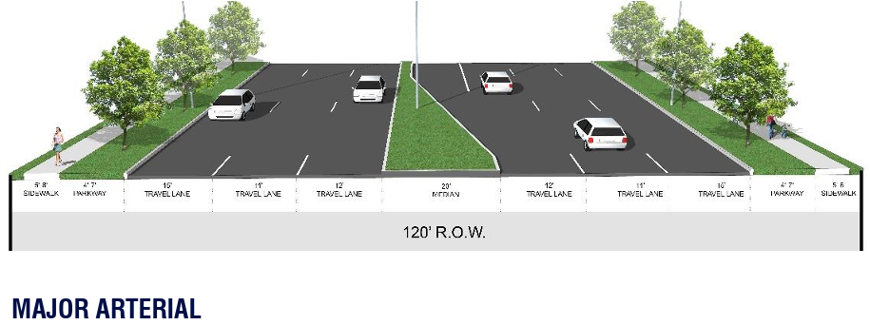
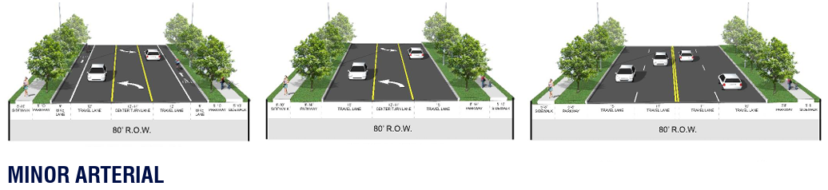
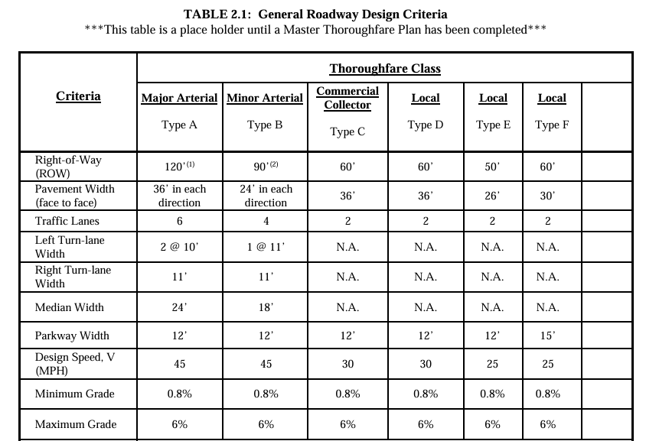
Mobility
Thoroughfare Map
Mobility Framework: Improve visibility and access into the City while focusing on internal road quality and connections.
Action Items:
Coordinate with local, region, and state partners on transportation projects.
Prioritize Shady Shores Road and Hundley Drive as complete streets.
Other Items:
98% of online survey respondents believe that improving streets/infrastructure was
During plan reviews, City of Lake Dallas’s Engineering Design Manual is utilized to establish requirements for Roadways, sidewalks, trails and other mobility requirements.
ROADWAY CROSS SECTIONS
Add thoroughfar map
Sidewalks
Add overall objective of what they are trying to do
How they identified the different street types
Reference engineering design manual are rules and regulations that are utilized with the visions and goals of the comp plan

Slide 11
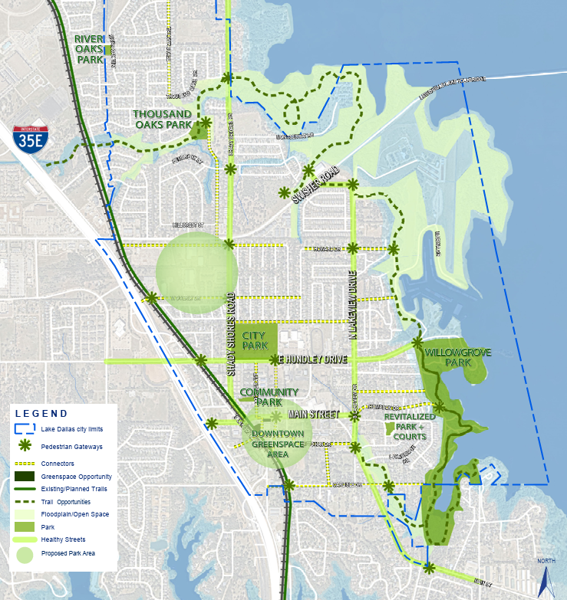
PARKS, TRAILS & OPEN SPACE
Trails Map
Parks Framework: Exceed park access standards by providing all residents access to a park within a quarter mile, connecting existing parks, and activating open space amenities throughout the City.
Action Items:
Prioritize development of bicycle and pedestrian improvements along major roads.
Preserve floodplain areas as natural open space.

Slide 12
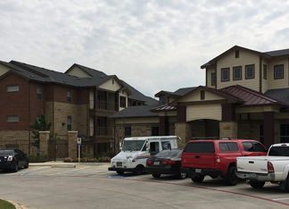
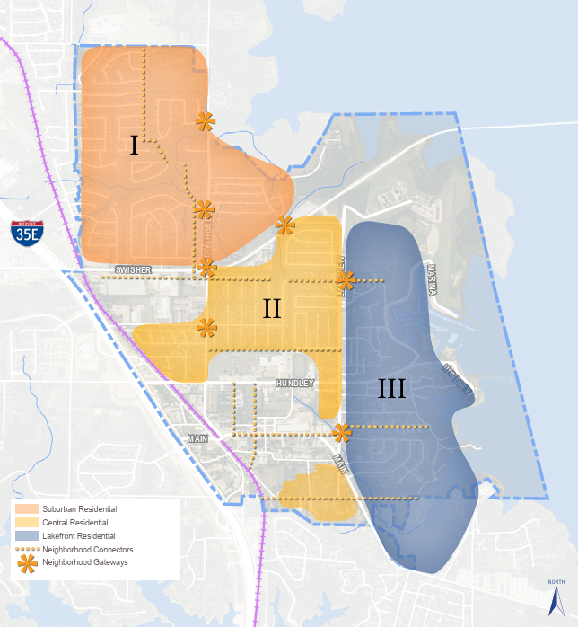
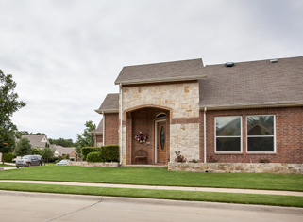
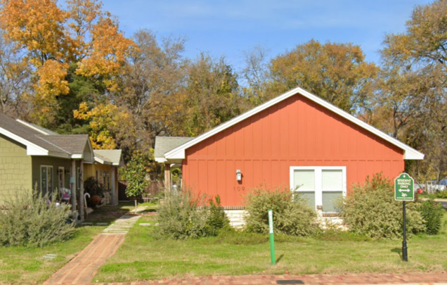
Housing
Housing Map
Housing Framework: Enhance existing neighborhoods and creative diverse, unique housing options to increase housing opportunities.
Community Input:
More Townhomes
Want to clean up mobile home communities
Need sidewalk repair in neighborhood
Would like live/work space
Clean and maintained residential neighborhoods.
Housing Types in Lake Dallas:
Suburban Residential
Single Family Homes
Central Residential
Tiny Homes
Apartments
Duplex’s
Lakefront Residential
Cottages
Mobile Homes
Townhomes

Slide 13
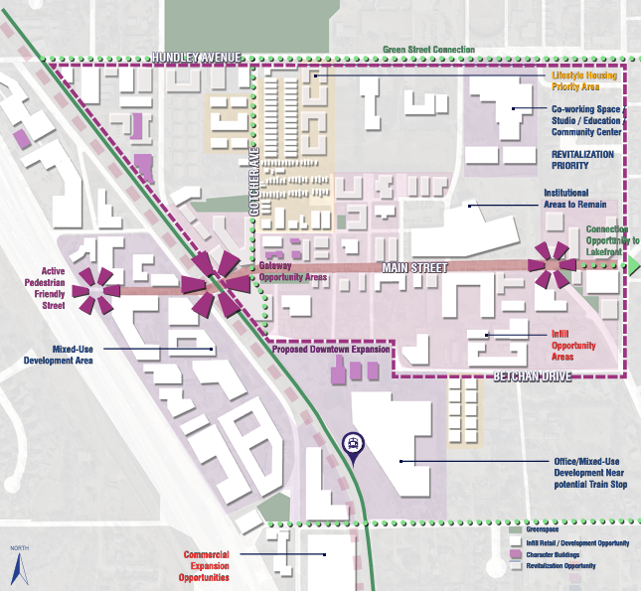
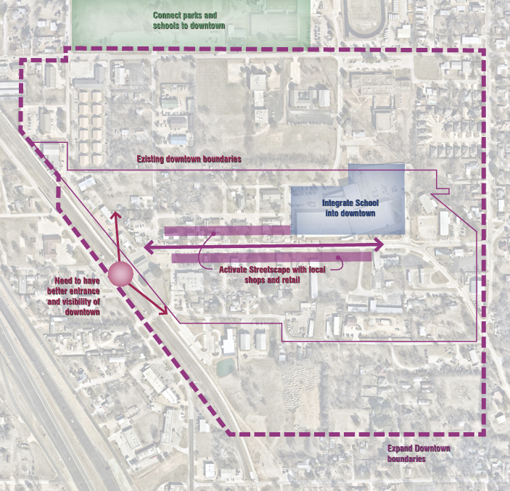
Downtown district
Downtown Recommendations Map
Downtown Framework: Expand the footprint of downtown and build local business and residential opportunities.
Action Items:
Reinstate the Economic Development Corporation with a focus on marketing downtown to potential developers and employers.
Prioritize pursuit of neighborhood-serving retail such as a sit-down restaurant.
Encourage a mix of housing types in downtown such as live/work spaces, townhomes, and tiny homes.
Other Items:
Add parking suggestions and sidewalk implementation
Prioritize revitalization and infill
Downtown Boundary Expanded

Slide 14
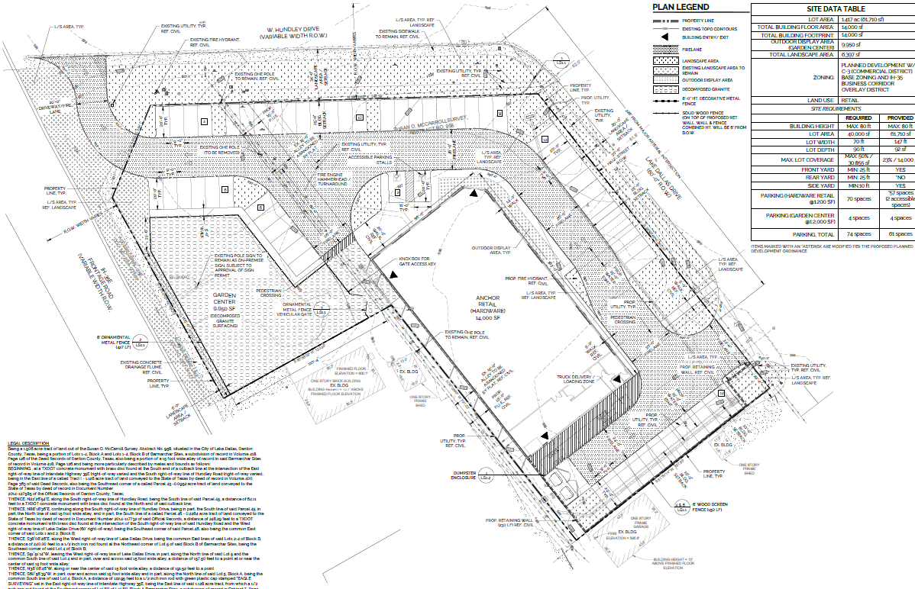
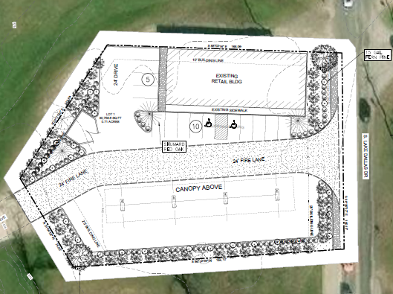
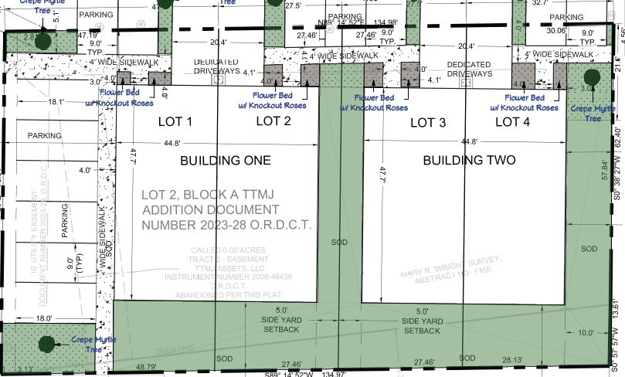
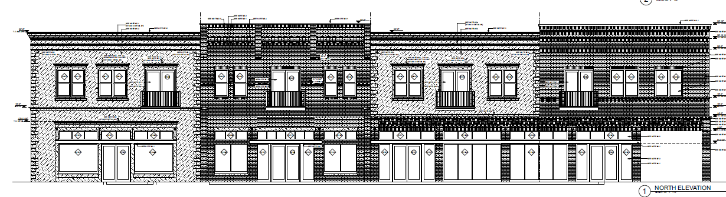
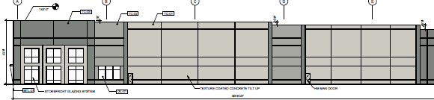
Re-development in Lake Dallas
I35E Corridor
ACE Hardware
631. S Lake Dallas Drive
Re-Development Areas:
I35E Corridor
Downtown District
Swisher Road Corridor
Feedback Regarding Re-Development:
53% of residence thought downtown should be prioritized for redevelopment
Expand the tax base through redevelopment of commercial areas.
.
Downtown District
TTMJ
312 Main Street
Swisher Road Corridor
Swisher Industrial

Slide 15
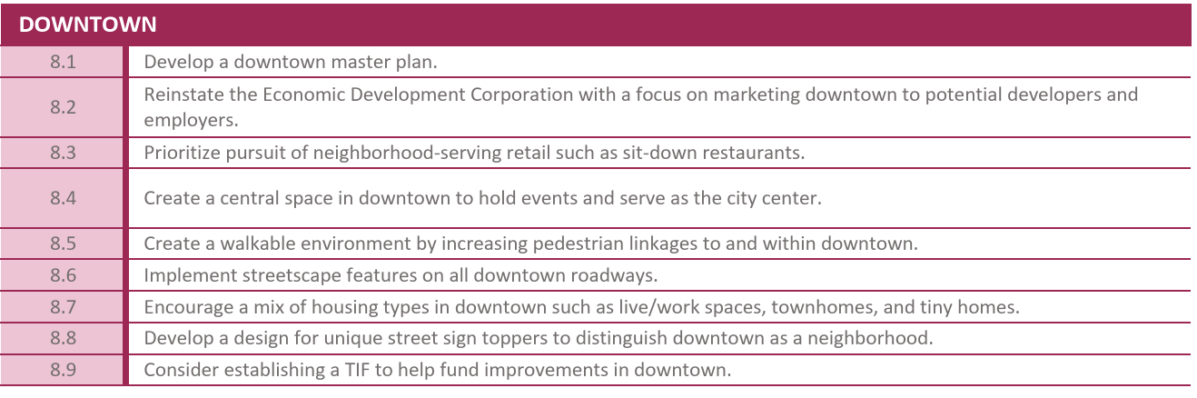
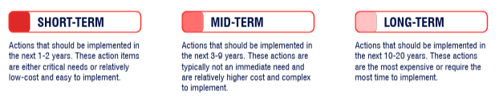
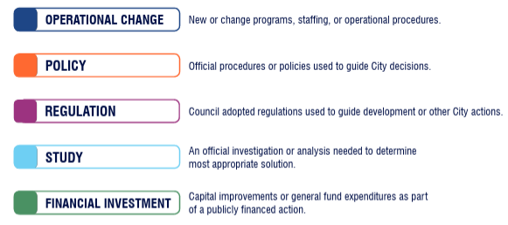
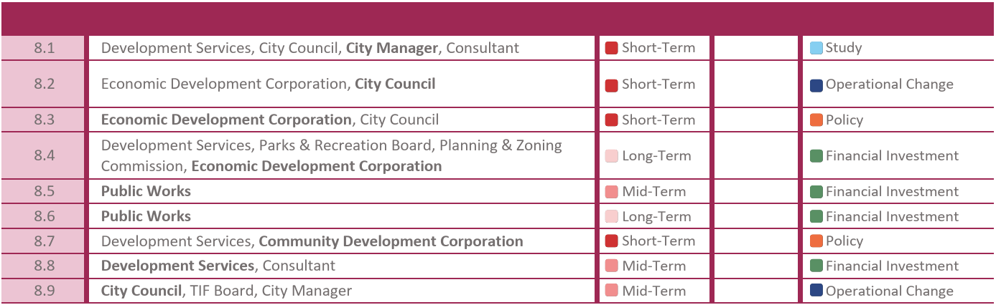
Implementation & monitoring
Implementation Framework: A detailed implementation action plan to achieve the overall plans vision for each of the major components of the plan.

Slide 16
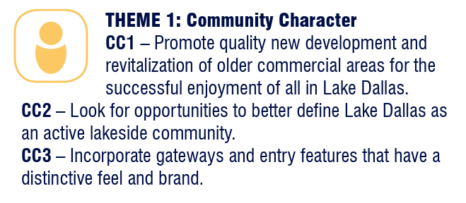
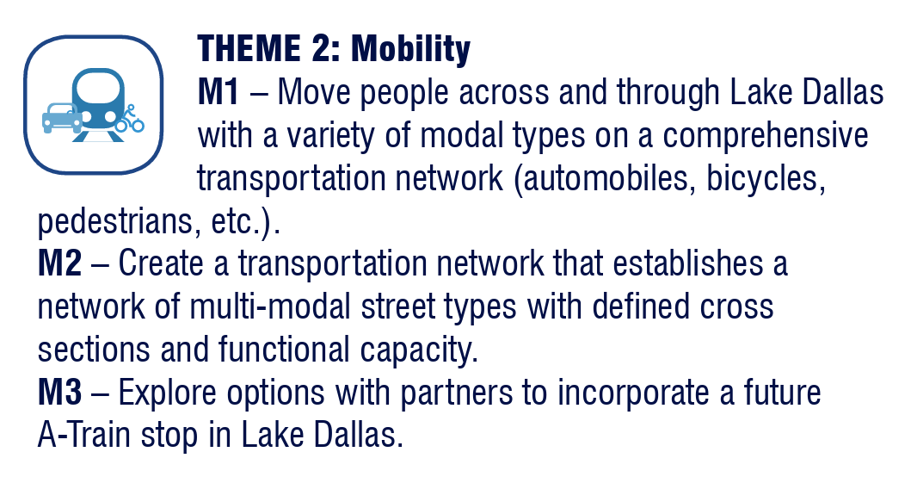
Goals + implementation from comprehensive plan
Ace Hardware
TTMJ Townhomes
Swisher Industrial
631 S. Lake Dallas Drive
New Roads/Sidewalks: Shady Shores + Hundley Drive
Encouraging on new applications the improvement and add new sidewalk connections.

Slide 17
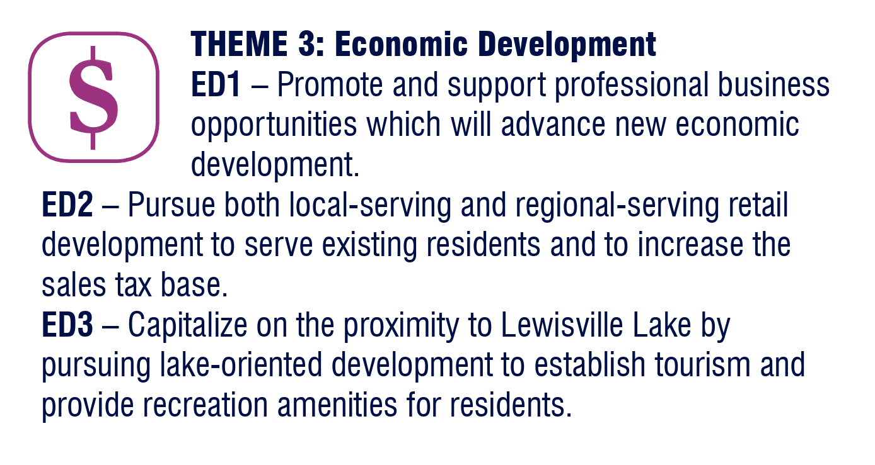
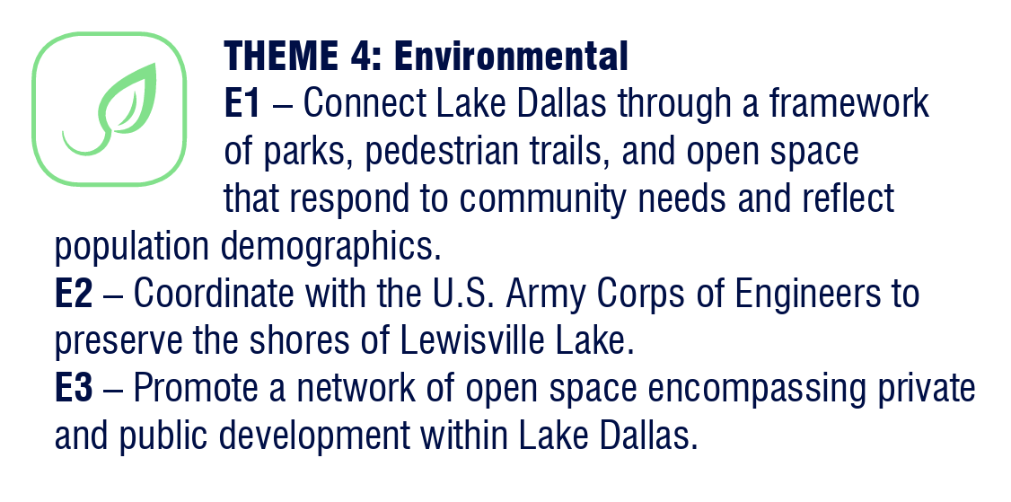
Goals + implementation from comprehensive plan
Ace Hardware
312 Main Street
Old City Hall has been transformed into a business hub.
B.I.G. Grants
City purchased old homes next to Ace hardware to encourage additional business growth.
Old QT site is now being revitalized into a development that will increase property tax revenue for the City.
Increasing park usage with updates. New Trails and Sidewalks with Hundley Drive and Shady Shores.
Mini Pitches
Resurfacing tennis courts and Court updates
Updates to soccer field - new sod, irrigation and other items.

Slide 18
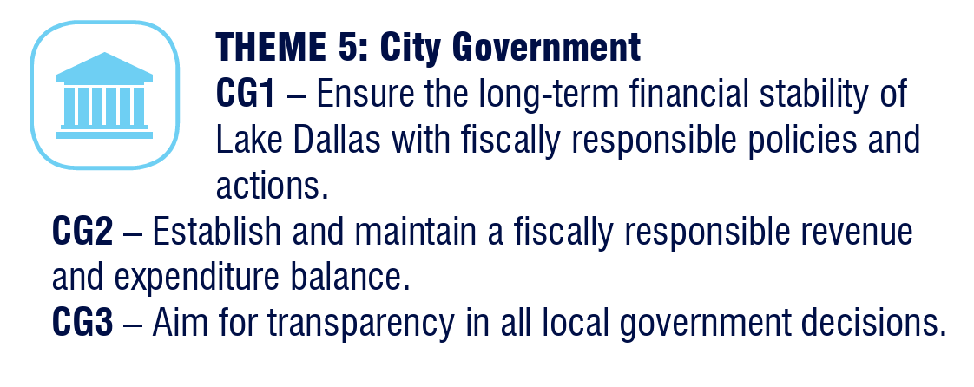
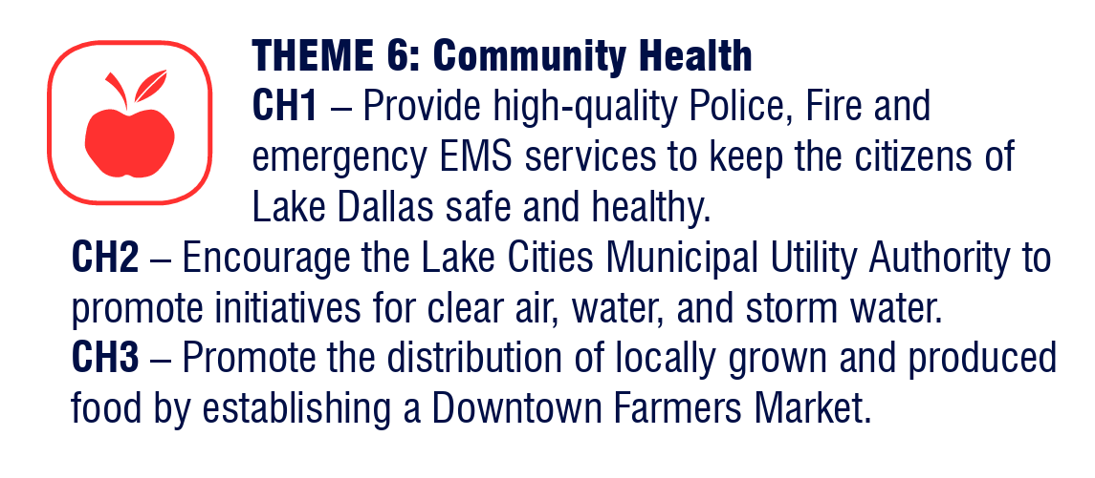
Goals + implementation from comprehensive plan
New Financial Software
New Financial Director was hired to help keep the City innovative and efficient with tracking
Teamed up with LCMUA on road repairs to coincide with their water and sewer line repairs.
All new water and sewer on Hundley and Shady Shores – City requested from County to cover additional expenditures.
New underground storm water system.

Slide 19
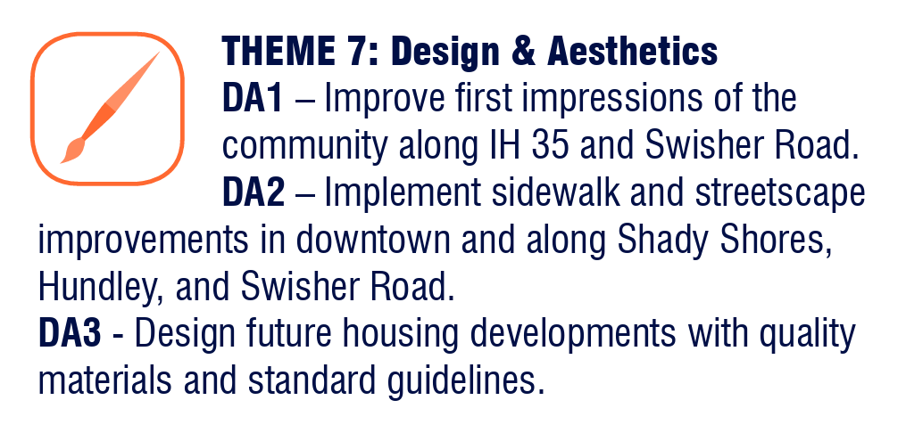
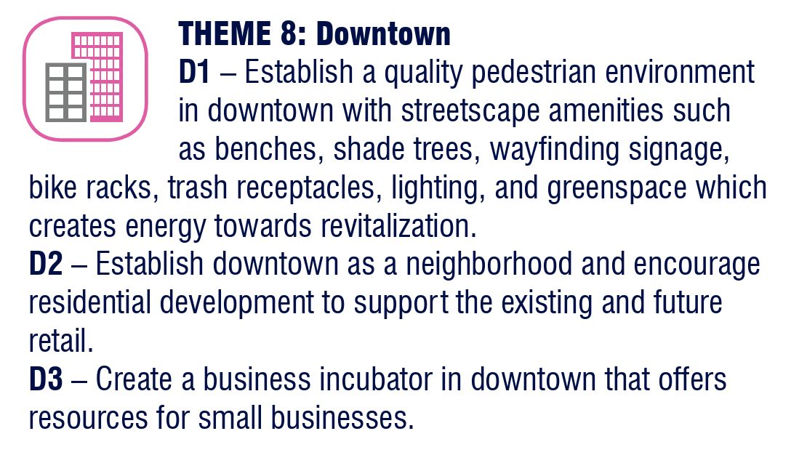
Goals + implementation from comprehensive plan
Additional landscaping along the main routes of Hundley Drive and Shady Shores.
631 S. Lake Dallas Drive and adding additional landscaping along I35 through development review process.
312 Main Street – Additional enhanced sidewalk and provided for more mixed use development
Walters Tavern- Increase business activities creating more of an active hub within the downtown area
TTMJ- Creates more walkable areas with housing being mixed in within the Downtown area

Slide 20
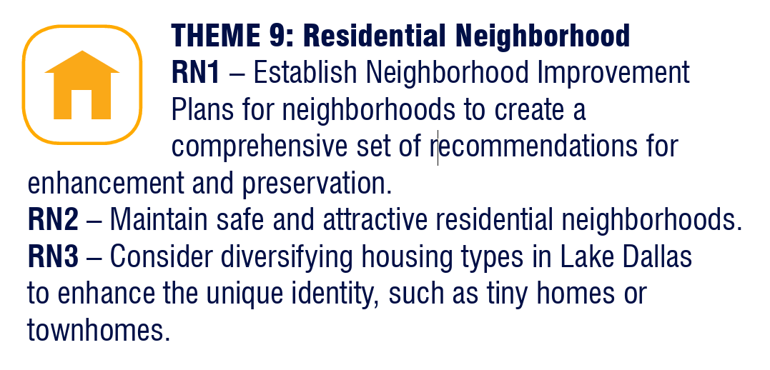
Goals + implementation from comprehensive plan
312 Main Street- Provides mix use housing option
TTMJ-Diversifies Housing

Slide 21
Recap Of Vision Lake Dallas 2030
Advanced redevelopment efforts along key corridors including I‑35E, Downtown District, and Swisher Road.
Delivered mobility improvements through roadway upgrades on Swisher Road and Hundley Drive.
Implemented enhanced streetscapes through updated design review processes and ordinance standards.
Expanded and diversified housing options including TTMJ and 312 Main Street.
Supported economic growth through initiatives such as Ace, B.I.G. Grants, and strategic acquisition of redevelopment properties.
Increased park usage and recreational opportunities, including mini‑pitches and upgraded soccer fields.
Strengthened infrastructure systems through coordinated strategic partnerships.
Boosted local business activity and expanded opportunities for commercial engagement.
Hosted a greater number of community events to attract residents and visitors to Lake Dallas.
Improve internal audits by hiring people and upgrading internal software.

Slide 22
Questions?

