Slide 1


Introduction | City of Lake Dallas
Stormwater Utility Overview
A Stormwater Utility is a user-fee-based funding program for the City’s drainage management activities and drainage infrastructure needs.
Authorized by Texas Local Government Code Chapter 552
Funding for current and future City drainage operating expenses and needs
Fees based on drainage characteristics
Alternative to Property Tax
Fees tie to service rendered
Can be administered by Utility Billing

Slide 2
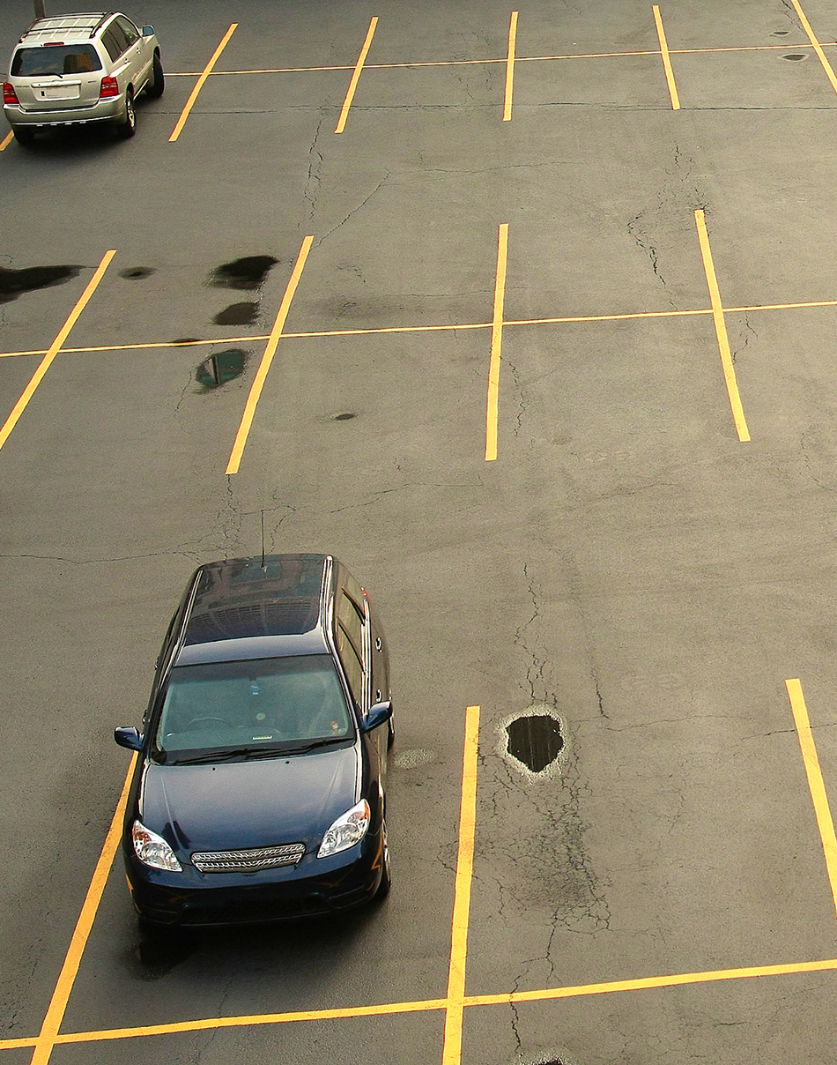
Billing System | City of Lake Dallas
STORMWATER BILLING SYSTEM
Must be able to tie impervious area by property back to accounts within utility billing system
Must be maintained periodically to ensure impervious area for new and existing properties are accurately reflected and accounted for
Potential issues:
Parcels without active water/sewer service
Multiple accounts on same parcel

Slide 3
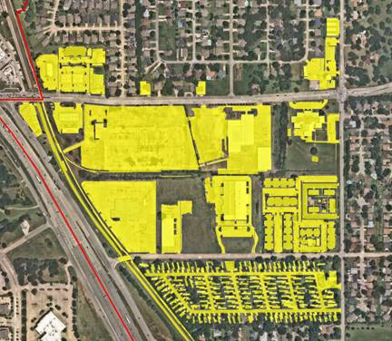
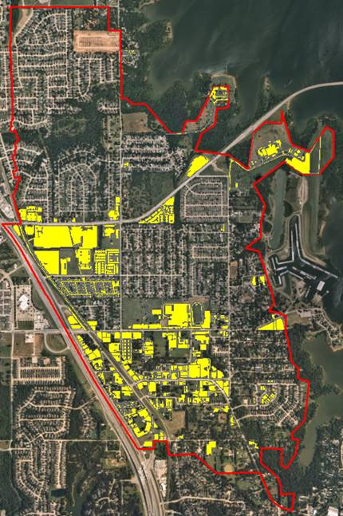
Impervious area determination | City of Lake Dallas
IMPERVIOUS AREA delineation for non-residential parcels

Slide 4

ERU Determination | City of Lake Dallas
1 ERU =
IMPERVIOUS AREA FOR TYPICAL SINGLE-FAMILY RESIDENTIAL UNIT
Total impervious area calculation = home + driveway + sidewalk + shed (or similar addition)
City of Lake Dallas
1 ERU = 3,220 sf impervious area
(Sampled 20 random residential lots within the City of Lake Dallas)
Shed
Home
Driveway and sidewalk
TYPICAL RESIDENTIAL PARCEL

Slide 5
Rate Analysis | City of Lake Dallas
ERU and revenue projections for FY 2022
ERUs broken out by residential and non-residential
Residential ERUs: 2,309
Non-Residential ERUs: 2,282
Total ERUs: 4,591
SWU Annual Revenue Projections | $6 (fee per ERU) | $9 (fee per ERU) | $12 (fee per ERU)
Residential | $166,248 | $249,372 | $332,496
Non-Residential | 164,333 | 246,499 | 328,666
Total | $330,581 | $495,871 | $661,162

Slide 6
Expense forecast | City of Lake Dallas
Forecast of Stormwater Expenses

Slide 7
Expense forecast | City of Lake Dallas
breakdown of Stormwater Expenses
 | FY 2022 | FY 2023 | FY 2024 | FY 2025 | FY 2026
Total Operation | 24,880 | 25,574 | 26,291 | 27,052 | 27,841
Total Capital Outlay | 250 | 257 | 264 | 272 | 280
Total Cash Capital | 4,427 | 100,000 | 100,000 | 100,000 | 100,000
Total New Program O&M | 421,216 | 233,040 | 322,259 | 330,080 | 338,108
Total Debt Service | - | 69,999 | 69,999 | 69,999 | 69,999
Total Expenses | $450,773 | $428,870 | $518,813 | $527,403 | $536,228

Slide 8
Fund balance summary | City of Lake Dallas
Forecast of Stormwater utility
Assuming annual growth of 25 additional ERUs
 | FY 2022 | FY 2023 | FY 2024 | FY 2025 | FY 2026
Beginning Fund Balance | $0 | $45,098 | $114,799 | $97,257 | $73,825
Total Expenses | $450,773 | $428,870 | $518,813 | $527,403 | $536,228
Monthly Billable ERUs | 4,591 | 4,616 | 4,641 | 4,666 | 4,691
Total Revenue ($9 per ERU) | $495,871 | $498,571 | $501,271 | $503,971 | $506,671
Over/Under Recovery ($) | $45,098 | $69,702 | -$17,542 | -$23,432 | -$29,557
Over/Under Recovery (%) | 10.00% | 16.25% | -3.38% | -4.44% | -5.51%
Ending Fund Balance | $45,098 | $114,799 | $97,257 | $73,825 | $44,269

